Slide 1
USING LAMBDA FUNCTION WITH AMAZON S3

Slide 2
WHAT IS S3?
Amazon S3 (Simple Storage Service) is a scalable object storage service offered by Amazon Web Services (AWS).
It's designed to store and retrieve large amounts of data, such as documents, images, videos, backups, and other files.
S3 is widely used for its high durability, availability, and performance, making it a popular choice for cloud storage.

Slide 3
WHAT IS LAMBDA FUNCTION?
AWS Lambda is a serverless computing service provided by Amazon Web Services (AWS) that allows you to run code without provisioning or managing servers.
A lambda function in programming refers to a small, anonymous function that is defined using the lambda keyword.
Lambda functions are often used for short-lived tasks, such as when passing a function as an argument to another function.

Slide 4
WHAT IS IAM ROLE?
An IAM Role (Identity and Access Management Role) in AWS is a set of permissions that define what actions are allowed and denied on AWS resources.
IAM roles are similar to IAM users, but they are designed to be assumed by entities, such as AWS services, other users, or applications, rather than being tied to a specific person.

Slide 5
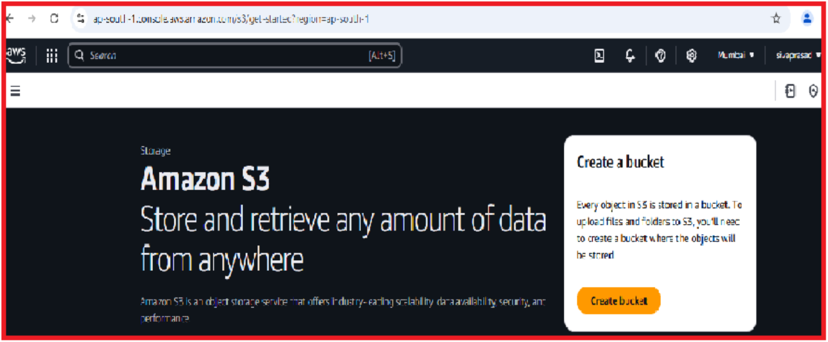
STEP 1:TO CREATE S3 BUCKET
Click on S3 service in AWS CONSOLE.
Click on create bucket in s3 .

Slide 6
Click on create bucket --bucket name –click on block all public access—bucket versioning—encryption type—bucket key.

Slide 7
Bucket is successfully created the below image shown.

Slide 8
STEP 2:IAM ROLE
Click on the IAM Service in AWS CONSOLE.
Create IAM ROLE .

Slide 9
Click on the use case as lambda and attach policies and role details and the role has been created.

Slide 10
STEP 3:CREATE LAMBDA FUNCTION
Create function –function name—python 3.9—existing role –create function.

Slide 11
Add trigger in lambda function.
Go to s3 bucket in new tab and create folder .

Slide 12
Add folders to bucket.

Slide 13
Again go to trigger in lambda function and add prefix and suffix.

Slide 14

Go to code in lambda function.
Again go to s3 bucket upload files to s3 bucket.

Slide 15
Again go to lambda function deploy code.

Slide 16
STEP 4:CLOUDWATCH
Go to cloud watch and select log groups .

Slide 17
Again go to s3 bucket add files to s3 bucket.

Slide 18
Again go to lambda function and deploy code.

Slide 19
Go to cloud watch and click on the log streams and select the log stream.

Slide 20
Click on the log stream and select the records in it .

Slide 21


